Slide 1



Home Safety Checks

Slide 2


Types of visit
Visit Type
Home Safety Check
Home Safety Check –VP/High risk P1 – P3
Who conducts the visit at LFRS?
Conducted by Operational Personnel and Partner agencies.
Conducted by specialist trained Community Educators (CEs).
What equipment can be supplied during the visit?
Our standard Fire Angel ST-750 optical smoke alarms can be fitted.
Our standard Fire Angel ST-750 optical smoke alarms can be fitted.
Our specialist sensory impairment, wirelessly linked smoke alarms can be fitted.
CEs can assess for equipment such as lifeline, grab rails, half steps and chair raisers to aid with mobility.
Sometimes CEs can offer a free Carbon Monoxide alarm (funding and stock dependant).
What advice, information and guidance can be given
All fire safety advice, including escape plans, testing smoke alarms, kitchen and electrical safety, shutting internal doors at night, what to do in the event of a fire etc.
All fire safety advice covered during a HSC, plus crime prevention advice and slips, trips and falls advice if needed.
CEs can also discuss a range of health and wellbeing factors, and make referrals for additional help and support if needed.

Slide 3

Topics covered in HSC
Home fire safety
Hazard spotting
Fire safety advice
Bedtime routine
Escape planning
Smoke detection
Risk reduction equipment (e.g. deaf alarm, letter box lock)
Reducing risk of fire related crime
Other areas
Physical health
Frailty, mobility and falls prevention
Keeping warm
Social isolation
Mental health (including dementia)
Hoarding
Smoking
Electronic cigarettes
Substance use
Medication
Home security

Slide 4
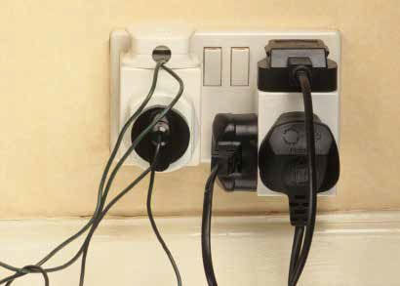
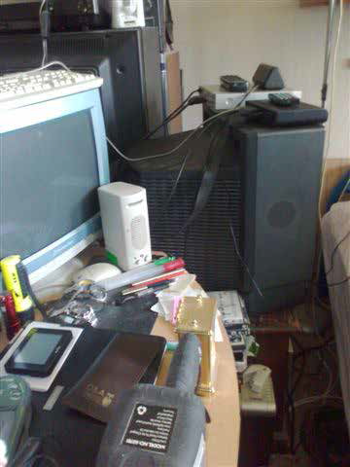
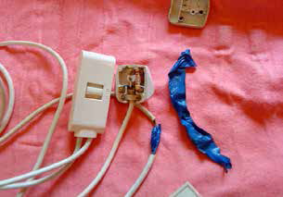
Risk Identification
Hoard with electrical overloading
Faulty Electric Blanket

Slide 5
Hoarding – Why is it an issue for Fire Service?
Higher fire loading than normal
Hides the true fire risk
Delays smoke detection activation
Reduces the opportunities for escape – e.g. blocked exits
Increase the time for escape
Increases the time for the fire service to get in to effect a rescue
Prevents maintenance of electrics etc.
More likely to use higher risk heating sources, e.g. convection or radiation heaters

Slide 6
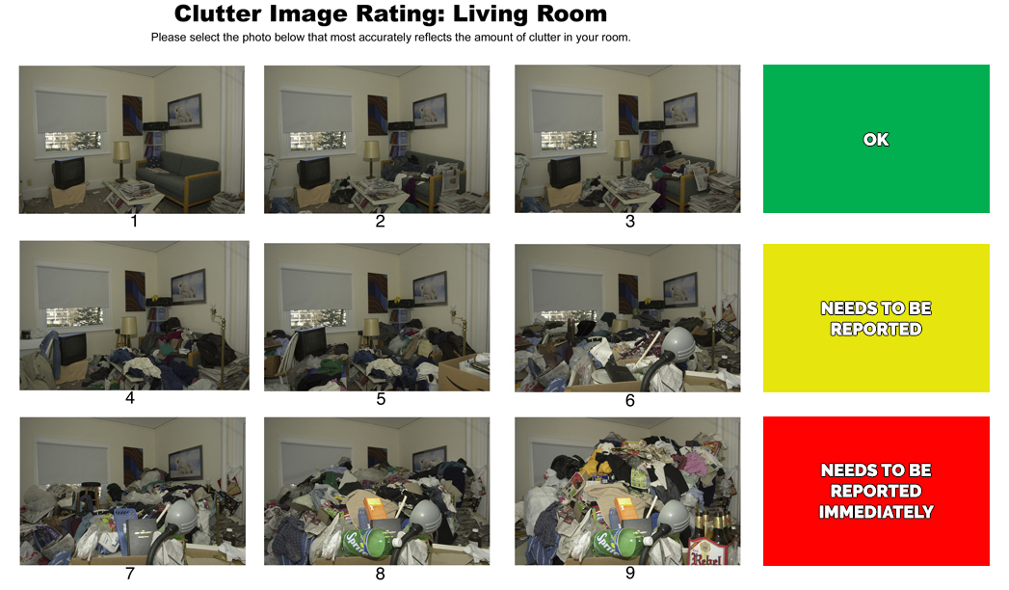
Hoarding – Clutter Image rating matrix

Slide 7
Referral Process
Secure egress form
Leicestershire Fire and Rescue Service Secure Form (egressforms.com)
First Contact
Urgent referrals (Arson risk) can be taken over phone 24/7
SMS service for hard of hearing

